Slide 1

Tablet Rollout

Slide 2
We recently finished the test launch of our tabletop menu tablets at two pilot locations. This milestone was achieved thanks to the collaborative efforts of our team over the past two month The tasks included:
Coordinating with internal teams, including marketing and our head chef, Carter
Procuring tablets based on technical specifications
Developing and training staff at both locations
Summary

Slide 3
The survey was conducted to assess tablet pilot based on the following indicator category:
●Ease-of-use
●Functionality
●Efficiency
●User experience
Overview

Slide 4
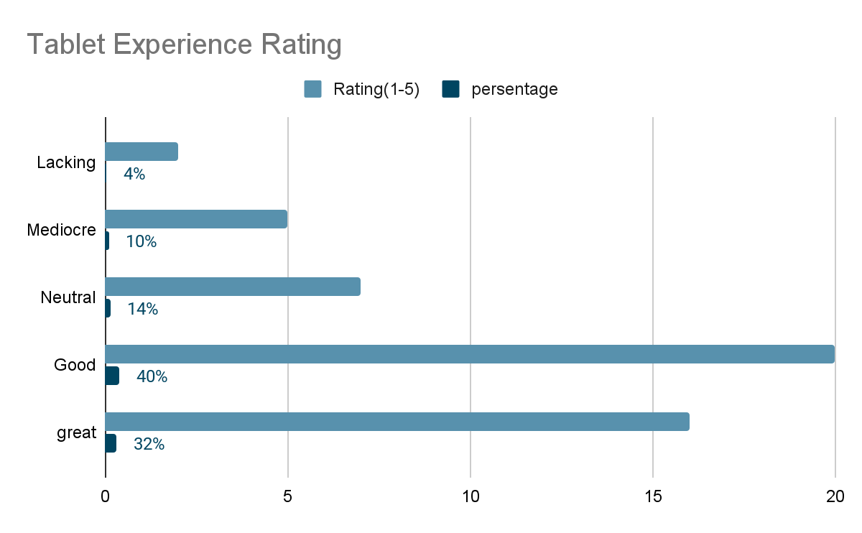
According to the survey result :
-86% received their food in less than 30 minutes.
-72% of customers find the kitchen prepare your order
correctly.
-86% of customers had a positive or neutral experience with the tablets
Findings
Opportunities:
-54% of customers had to wait over fifteen minutes for a table.
-26% of customers find difficulty to to order directly from the menu on the table.
-Only 16% of customers signed up for the Birthday Club using the tablets.

Slide 5
Identify and address the reasons why our customers are waiting over 15 minutes to be seated.
Analyze current table turnover times to determine possible improvements.
Address issues with the tablet's interface and user experience identified by customers.
Follow up with marketing regarding the tablet design.
Provide feedback to the vendor for software enhancements.
Next Steps

Slide 6
Give customers the option to use the tablet or interact with a waiter.
Explore the reasons behind customer preferences through additional surveys and feedback.
Offer customers the choice in the meantime.
Continue refining the process and collecting more data.
Determine why some customers prefer a waiter to better meet their needs.
Next Steps

